Slide 1
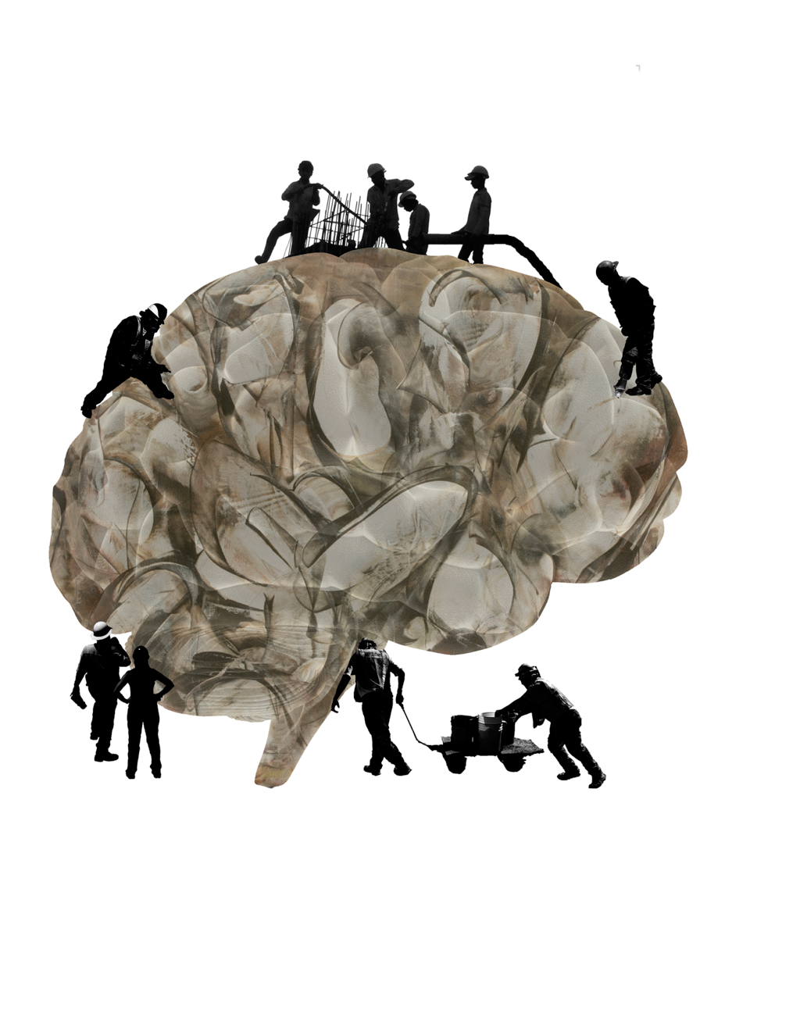


The Legendre Memory Unit A neural network with optimal time series compression
Chris Eliasmith
Centre for Theoretical Neuroscience University of Waterloo

Slide 2
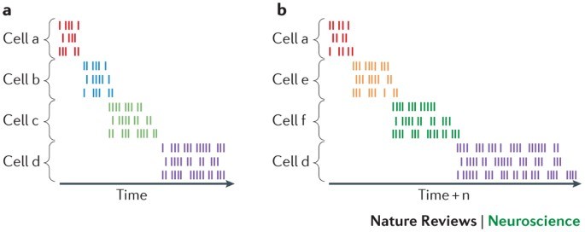
Biological systems remember continuous time
The Problem
People don’t just remember order, but also temporal distance (retrospective and prospective timing)
Biological systems need to continuously update working memory
“Time cells” have been discovered in the brain (HC, EC, BG)
Notes:
Add (graph showing AI/Model growth, compute demands, etc power being used)

Slide 3
A New Neural Network

Slide 4
The problem
The Problem
Perfect continuous delay is an infinite dimensional problem
Infinite frequency content over any finite interval requires infinite information preservation
Input
Delay/Memory
Output
Time
Notes:
Add (graph showing AI/Model growth, compute demands, etc power being used)

Slide 5
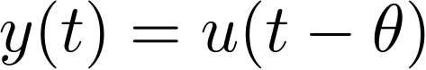
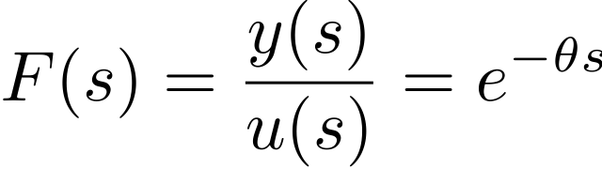
The problem
The Problem
Ideal continuous delay:
Or, in the Laplace domain:
Equivalently:
Optimal finite version?
Notes:
Add (graph showing AI/Model growth, compute demands, etc power being used)

Slide 6
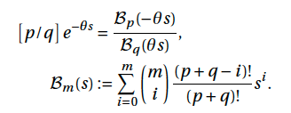
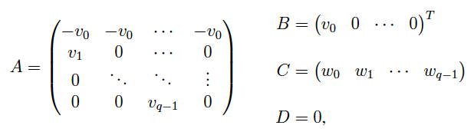
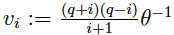
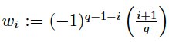
The solution
The Problem
The best approximation of any function with a rational function of order p/q is given by the Padé approximants
Choosing p=q-1, the state space becomes:
Notes:
Add (graph showing AI/Model growth, compute demands, etc power being used)

Slide 7
The solution
The Problem
Our ‘Legendre Delay Network’ (LDN), is the optimal finite solution to this infinite dimensional system
Notes:
Add (graph showing AI/Model growth, compute demands, etc power being used)

Slide 8
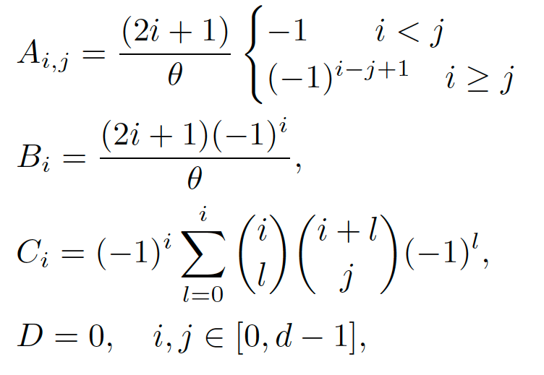
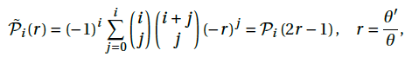
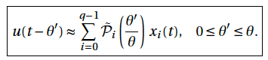
The solution
The Problem
We can then convert that LTI to a normalized form:
Projecting this state space onto the shifted Legendre polynomials
Gives
Notes:
Add (graph showing AI/Model growth, compute demands, etc power being used)

Slide 9
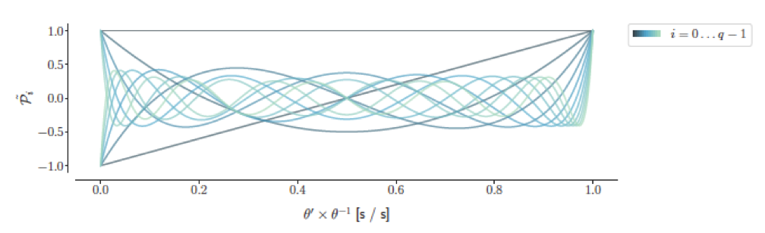
The solution: Examples
The Problem
For q=6 this results in the following matrices
For q=1 this system is a first-order low pass
Shifted Legendre Basis
Notes:
Add (graph showing AI/Model growth, compute demands, etc power being used)

Slide 10
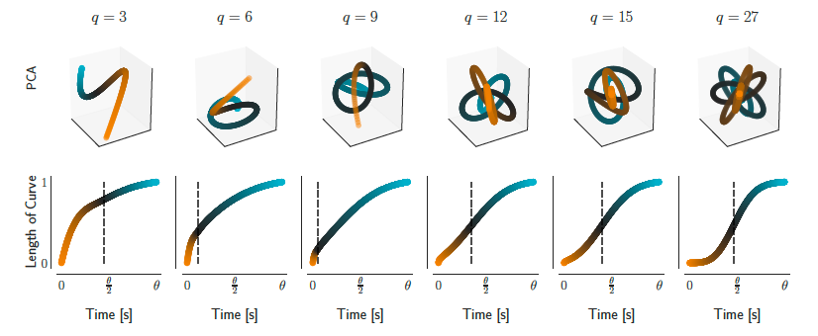
The solution: Impulse response
The Problem
Notes:
Add (graph showing AI/Model growth, compute demands, etc power being used)

Slide 11
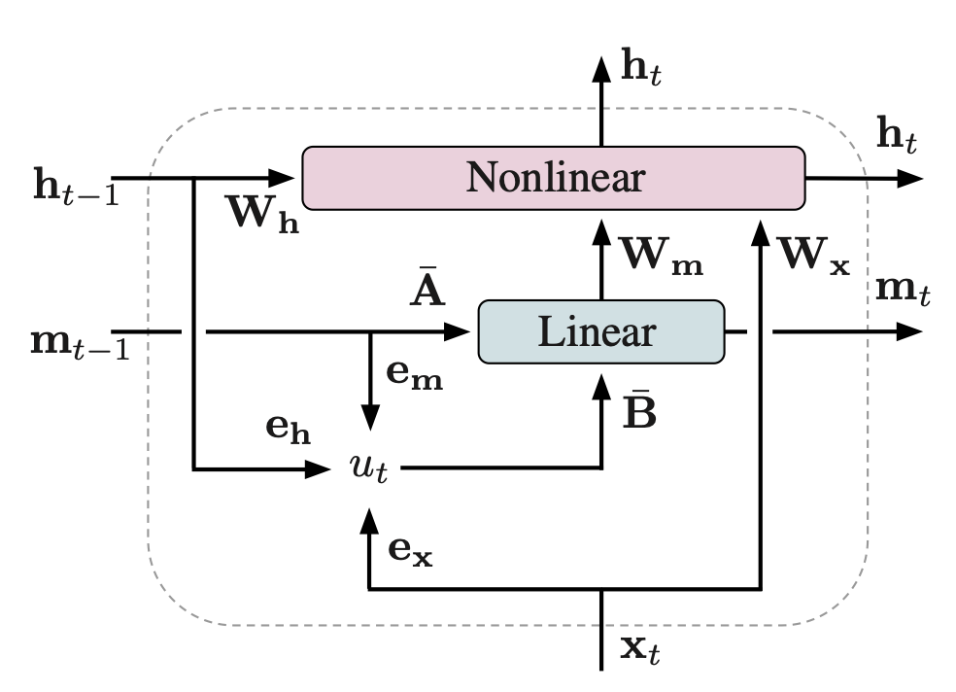
The Legendre Memory Unit (LMU)
The Problem
The LMU has this linear system at the core of its architecture.
This provides state-of-the-art performance and is parameter-efficient
Neural Connection: Explains time cells, dynamic, spiking (or not)
Notes:
Add (graph showing AI/Model growth, compute demands, etc power being used)

Slide 12
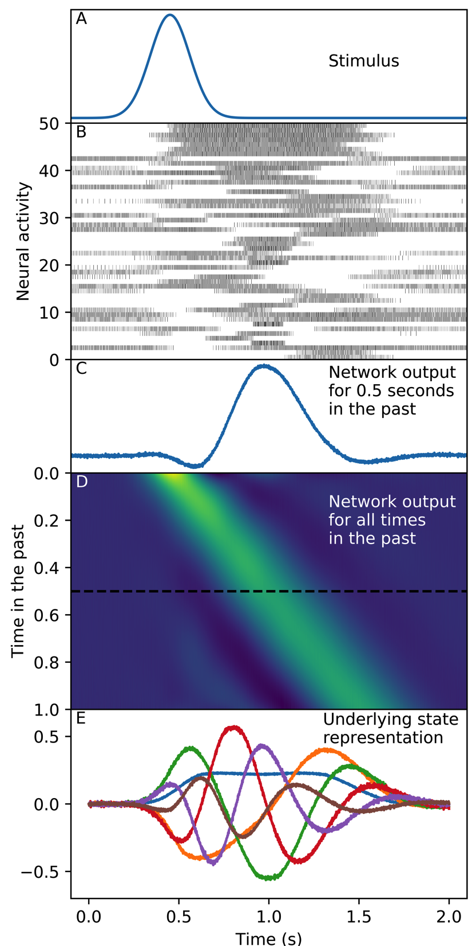
Time Cells

Slide 13
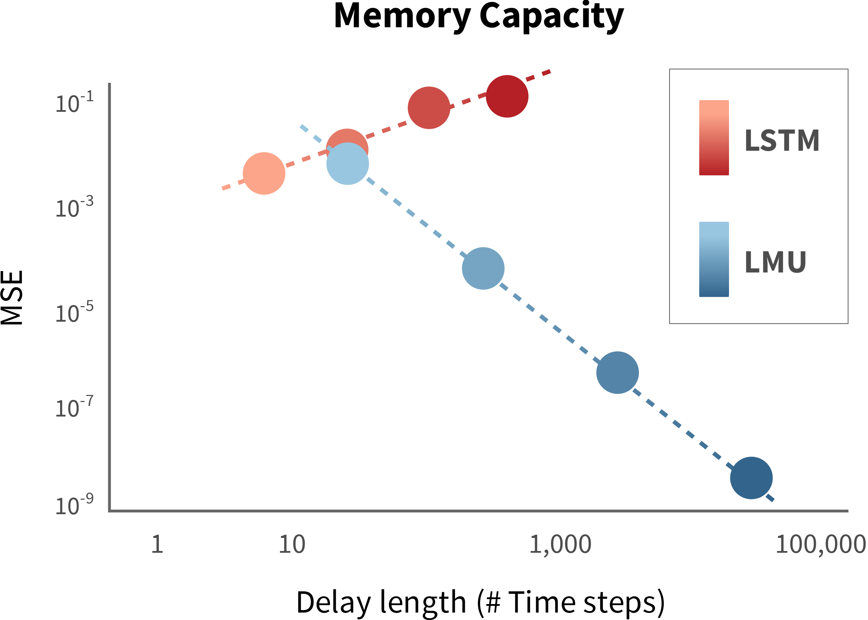
Efficient and Accurate
Better accuracy with fewer parameters means using less power.
The LMU with 500 parameters outperforms LSTMs with 41,000 parameters.
LMUs are 1,000,000x more accurate while remembering 10,000x more data than LSTMs.

Slide 14
Time Series AI

Slide 15
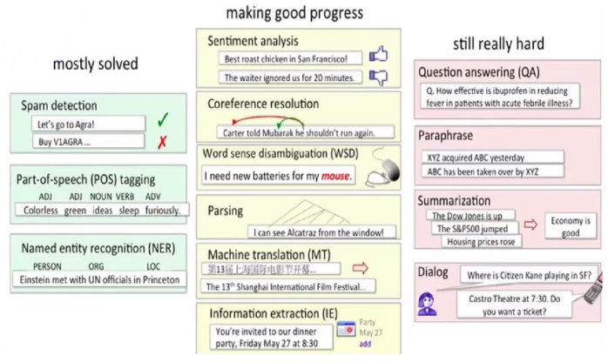
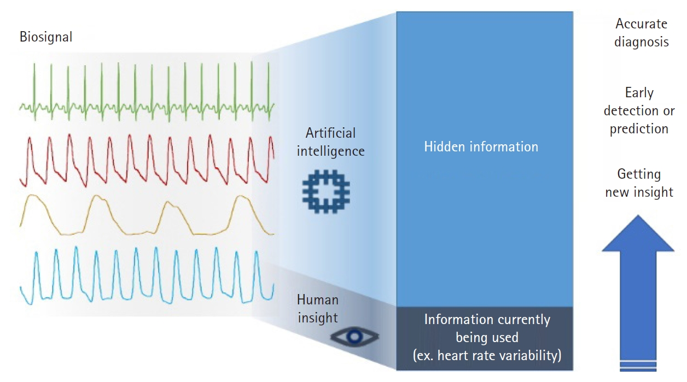
Time Series Problems
The Problem
Speech recognition
Language processing
Network monitoring
Stock market prediction
Network monitoring
Video processing (gesture recognition, tracking, etc.)
Biosignals monitoring
Signal processing
Notes:
Add (graph showing AI/Model growth, compute demands, etc power being used)

Slide 16

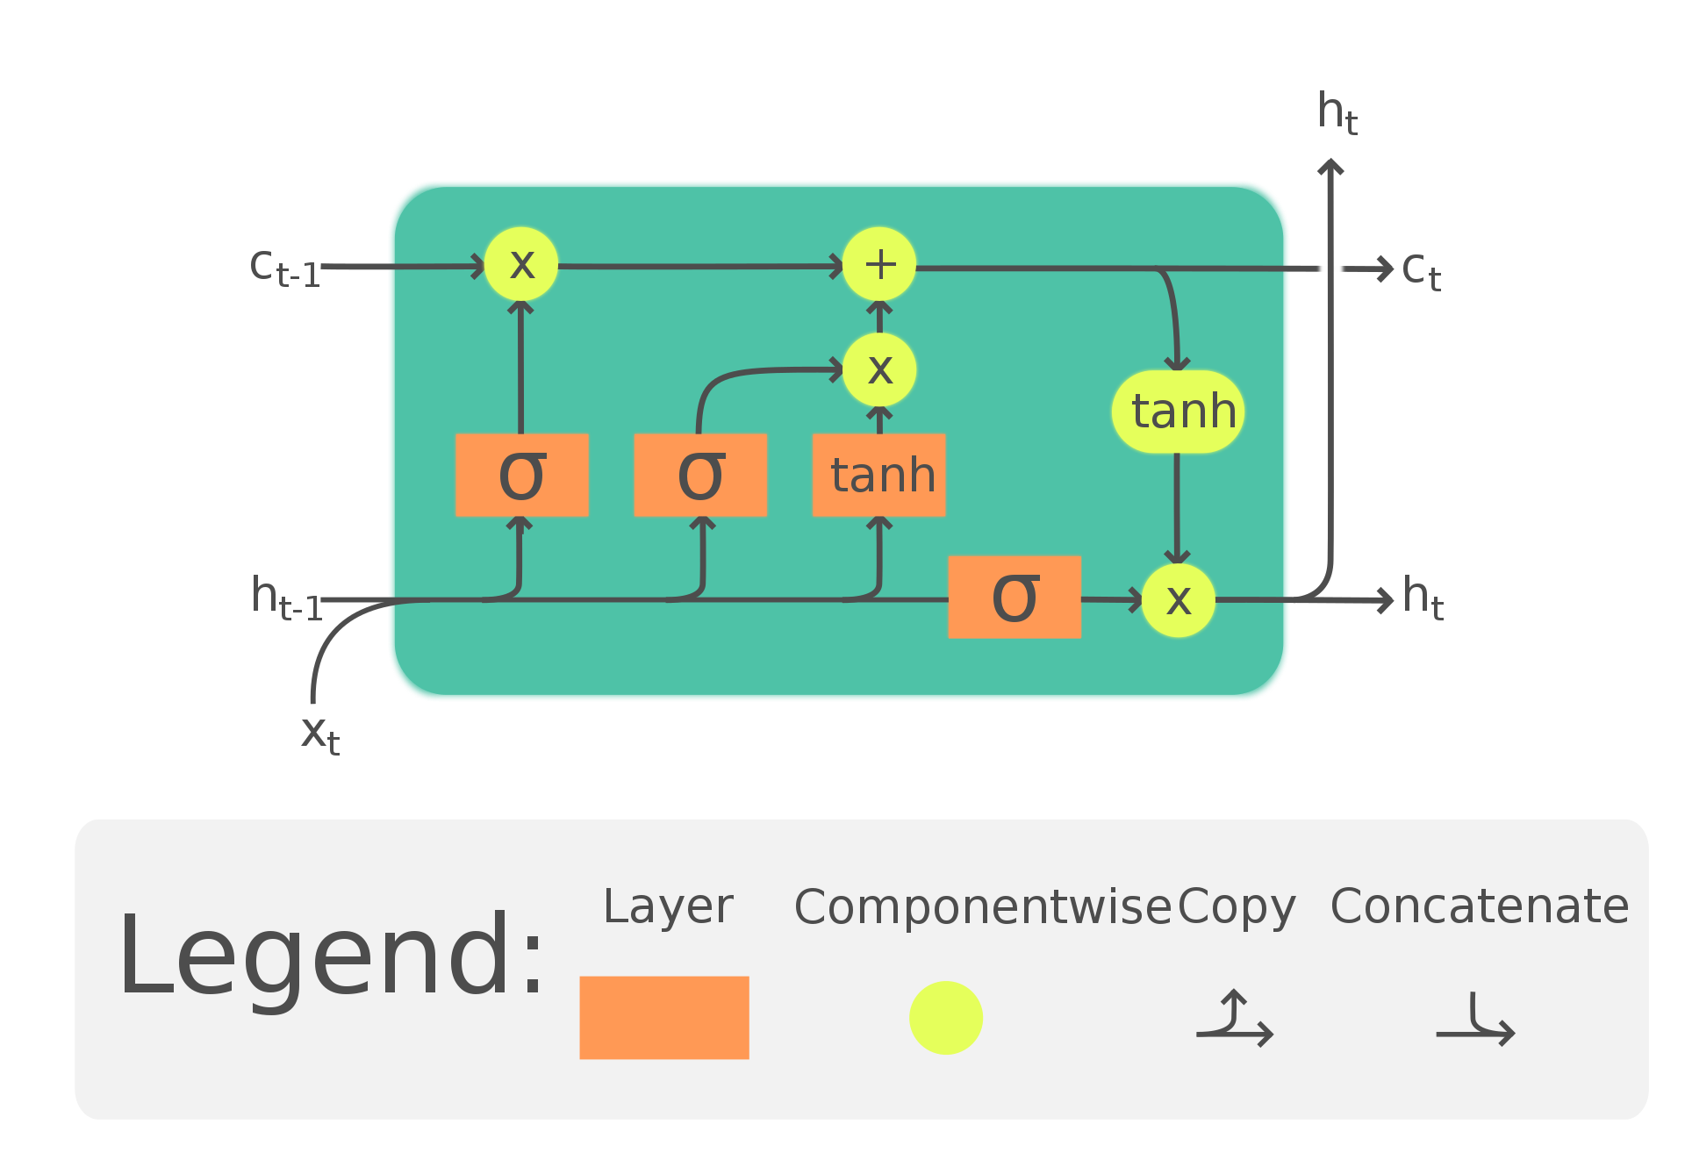
Long Short-Term Memory
The Problem
RNN
Proposed in 1995 as an improvement over vanilla RNNs
“LSTM has become the most cited neural network of the 20th century”
Generally very successful on time series data
LSTM
Notes:
Add (graph showing AI/Model growth, compute demands, etc power being used)

Slide 17
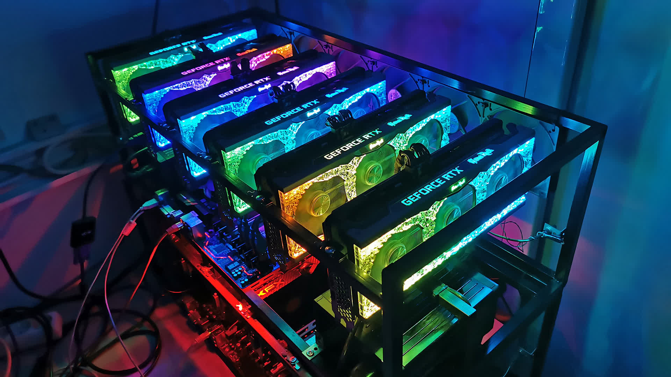
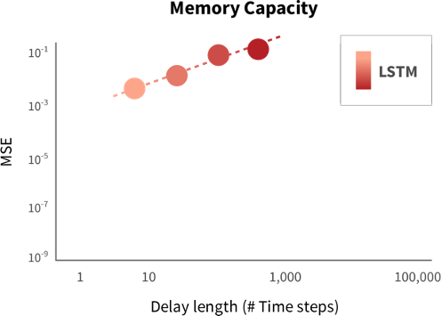
Limitations of the LSTM
The Problem
Very difficult to train at large scales (e.g., for NLP)
Cannot effectively parallelize training
‘Black box’ processing gives little insight into behavior
Sequences greater than 500-1000 samples cannot be effectively processed in practice
Notes:
Add (graph showing AI/Model growth, compute demands, etc power being used)

Slide 18
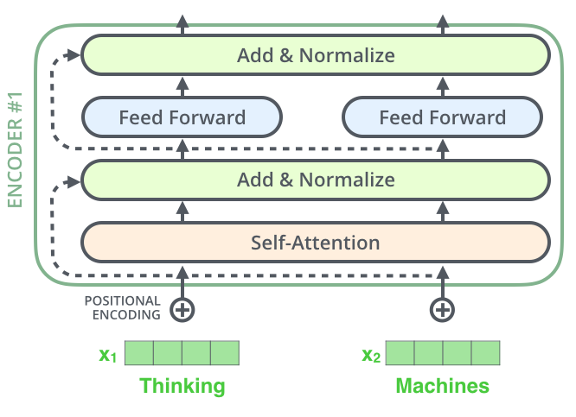
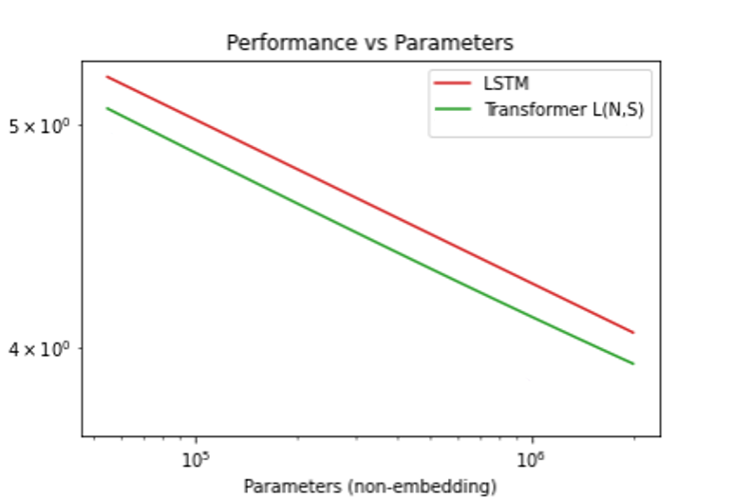
Transformer
The Problem
Borrowed ‘attention’ from LSTM work, makes time parallel
Purely feedforward training, leverages huge GPU farms
By far the dominant architecture for NLP (Google, Amazon, Apple, OpenAI, etc.)
OpenAI (2021)
Notes:
Add (graph showing AI/Model growth, compute demands, etc power being used)

Slide 19
A State-of-the-art Neural Network

Slide 20
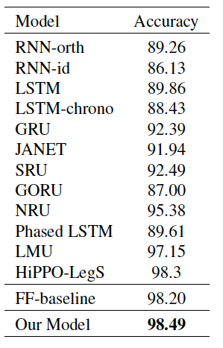
Benchmarks: SotA performance on psMNIST
Permuted, sequential MNIST is the standard benchmark for all new RNNs
Simplified LMU holds SotA record with 98.49% accuracy
LMU uses 60% fewer params than all other models
Simplified LMU
Notes:
Text8 – character level language model; 100MB of Wikipedia.
IWSLT – translation Vietnamese to English; 133k sentence pairs vocab of 7.7k and 17k

Slide 21
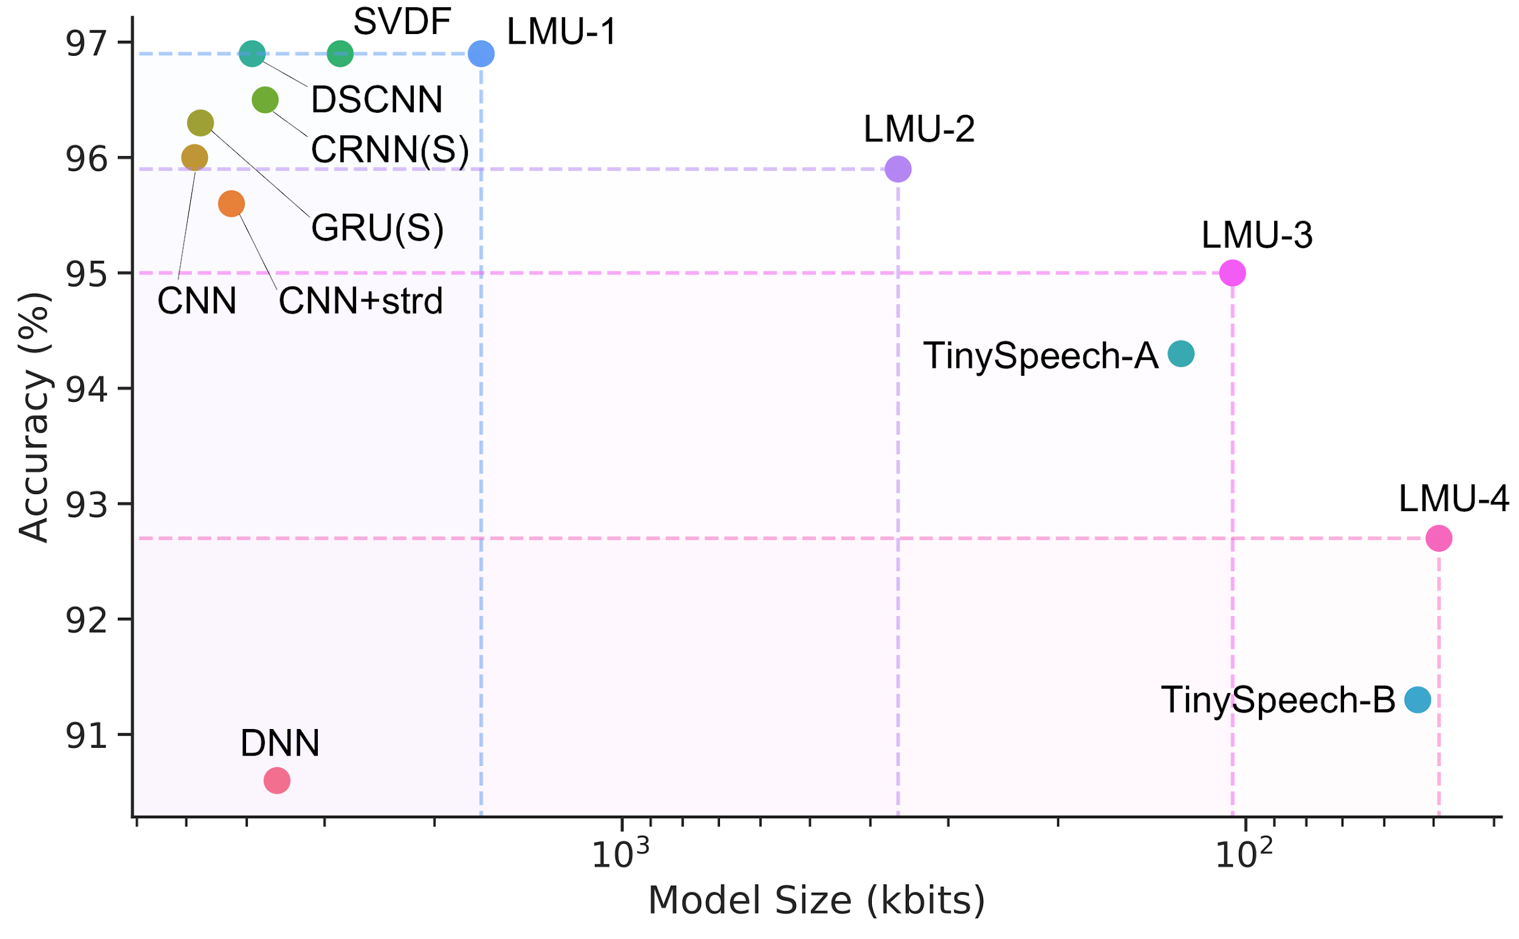
Practical: SotA on Keyword Spotting
At the edge
LMU
Google
Smaller 🡪
LMU gives the most power efficient streaming KWS models.
Notes:
- Bottom right not streaming

Slide 22
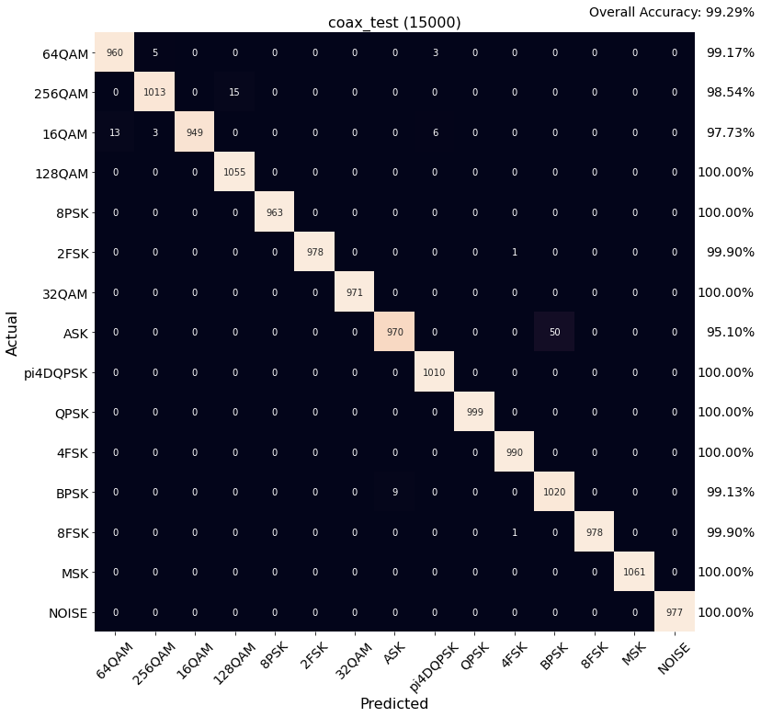
Practical: SotA on RF classification
The Problem
LMU has achieved 99.65% on coax and 95.15% on OTA
Coax is 3x reduction in error
OTA is 2x reduction in error
~300K params (relatively small), 1 layer LMU
Designed to run online (no buffering as with convnet)
Designed to run at the edge
Notes:
Add (graph showing AI/Model growth, compute demands, etc power being used)

Slide 23
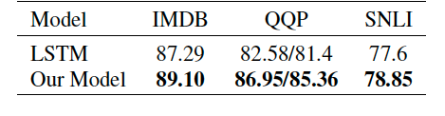
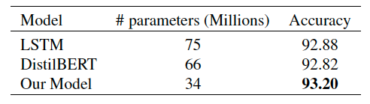
Scalable: SotA for Size and Accuracy
Natural language processing
IMDB sentiment analysis (160x fewer params)
QQP semantic similarity (650x fewer params)
SNLI inferential relations (60x fewer params)
Pre-training for IMDB
LSTM Radford et al. (2017) and Transformer Sanh et al. (2019)

Slide 24
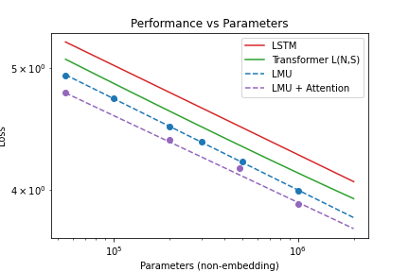
Scalable: SotA for Size and Accuracy
Fundamentally better scaling than transformers (OpenAI, 2021)
During learning and inference
Model | Compute | Memory
Transformer | O(N²) | O(N²)
LMU | O(N) | O(1)
N = sequence length
50% fewer parameters

Slide 25
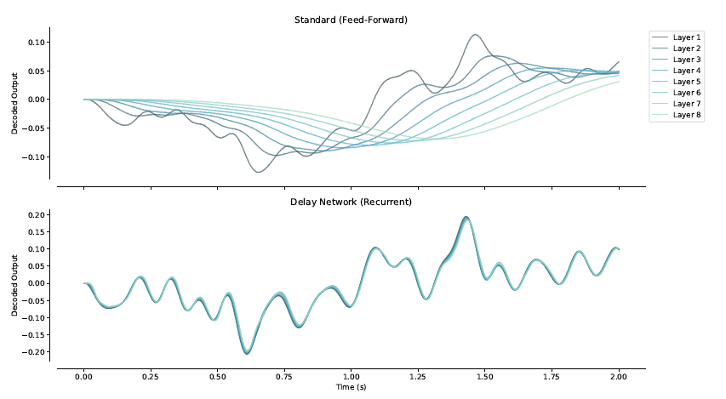
Other applications
The Problem
Biosignals analysis (e.g. R-peak detection, arrythmia)
Network monitoring (SoTA on KDD99)
Anomaly detection (SoTA on audio DCASE 2020 challenge)
Nonlinear dynamical system prediction (SoTA on MacKey Glass)
Signal processing, e.g., instantaneous signal propagation
Notes:
Add (graph showing AI/Model growth, compute demands, etc power being used)

Slide 26
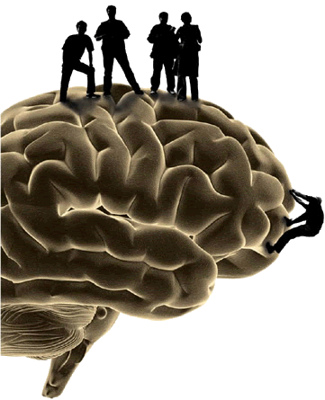
Further Information
Research, Papers
http://compneuro.uwaterloo.ca
Nengo software, Tutorials, Demo videos http://nengo.ai
Applied Brain Research
http://appliedbrainresearch.com
Notes:
takens theorem means you can learn the low dimensional embedding with 2d+1 delays on one measurement dimension

